Slide 1
Trustworthy Machine Learning -
Final Presentation
CSCI 4968/6968 - Trustworthy Machine Learning | Benjamin Avrahami | 04/05/2024

Slide 2
Outline
Background and Motivation
Related Work
Method Details and Implementation
Experimental Results (in progress!)
Discussion and Conclusion
Trustworthy Machine Learning - Project
04/05/2024

Slide 3
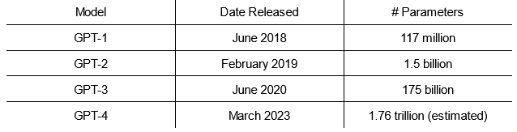
Motivation
Over the years, large language models have become better and better at creating correct and human-understandable outputs
At the same time, they have grown more and more unwieldy, with more layers and higher dimensionality, but in general just more parameters
Trustworthy Machine Learning - Project
04/05/2024

Slide 4
Motivation
Since the only adjustable parts of the models are their parameters, the knowledge must be stored in the parameters somehow
If we knew which part of the model led to improved behavior, we could focus on that and only increase the size of that area instead of the whole model, leading to a linear increase in model sizes, rather than exponential
In addition, if we knew what part of the model controlled a certain behavior, we could look at that area specifically instead of having to investigate the entire model (in the best case)
Trustworthy Machine Learning - Project
04/05/2024

Slide 5
Related Work
Jiang et al (2020) and Petroni et al (2019) attempt to capture the amount of knowledge various LLMs have internalized in their parameters without outside context
Ha et al (2022) uses a small (recurrent) neural network to generate the weights for a larger neural network to use
De Cao et al (2021) attempts to predict the change in the parameters that will yield a certain output, given that output
Trustworthy Machine Learning - Project
04/05/2024

Slide 6
Related Work
Zhu et al (2020) fine-tunes models subject to a maximum ℓ₂ norm to try and retain old facts while learning new facts from a dataset
Roberts et al (2020) attempts to maximize zero-shot learning capabilities of the model
Bricken et al (2023) try to map clouds of concepts to features derived from neural network nodes
Guu et al (2020) and Fevry et al (2020) simply add an explicit knowledge-storing structure inside the transformer
Trustworthy Machine Learning - Project
04/05/2024

Slide 7
Contributions
This project attempts to capture the effect of specific layers on the output by seeing what happens if they were not there, or at least if their influence on the rest of the model was reduced
Specifically, this is done by culling some weights from that layer to the next, proportionally decreasing the influence of the layer and therefore increasing the influence of the rest
Residual layers ensure that the meaning of previous layers are preserved
Trustworthy Machine Learning - Project
04/05/2024

Slide 8
Contributions
If the layer is important in constructing the output, removing it should impact the semantics of the output, while if it isn’t, removing it should have little effect
Then, a machine learning model is trained to predict which layers would have the most impact after being removed, allowing us to generalize about which layers would affect which inputs
Trustworthy Machine Learning - Project
04/05/2024

Slide 9
Contributions
Previous papers using hypernetworks (networks that predict networks) mostly used active learning
This allows for more flexibility, but the method used in this project addresses a few problems with active learning:
It is faster, since there are a predefined set of perturbations to the model weights instead of having to recalculate every output at every iteration
This allows for more localized effects, since viewing the gradient will cause every weight to get changed
Trustworthy Machine Learning - Project
04/05/2024

Slide 10
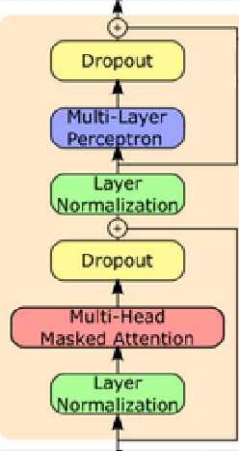
Background
Transformer architecture
In a decoder-only system, a transformer block contains one instance of self-attention (possibly with multiple heads) and a multilayer perceptron, with layer normalizations before each one and dropout and residual layers after each
The perceptron has one hidden layer, so it can be represented as two 1D convolutional networks (the weights going to the hidden layer, and the weights coming from the hidden layer) and an activation function
Trustworthy Machine Learning - Project
04/05/2024

Slide 11

Background
Self-Attention
Contextual values for each element of the input sequence are calculated using each key, query, and value vector, assuming that they are not masked
The attention vector for a token is the softmax of its (scaled) query value times each other key, and its contextual representation is the dot product of the attention vector and each token’s value
Trustworthy Machine Learning - Project
04/05/2024

Slide 12
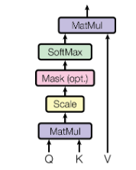
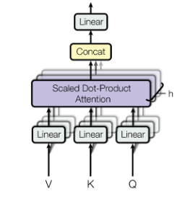
Background
If there are multiple heads to the attention, they have to be mixed together to produce a single contextual output
This can be done with a single 1d convolutional network, since it is a linear combination of the weights given to different heads
The query, key, and value weights are often combined into a single 1D convolutional network, since they are used in the same step, so attention is represented as two matrices
Trustworthy Machine Learning - Project
04/05/2024

Slide 13
Background
The class of model that is being examined in this project is GPT-2
It is large enough to have meaningful outputs, but small enough to be reasonably deconstructed
The architecture of GPT-2 is to have a word embedding vector, then a word position encoder, then a dropout layer, then 12 transformer blocks, then a linear map back to tokens
Ignoring dropouts, which are only used in training, residuals, activation functions, and the position encoder, there are 1 + (2+2)*12 + 1 = 50 modifiable layers in the GPT-2 architecture
Trustworthy Machine Learning - Project
04/05/2024

Slide 14
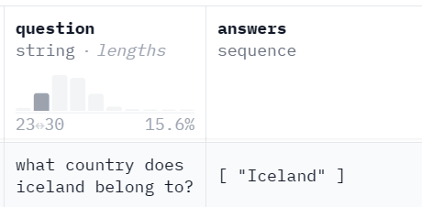
Method Details
The data being used in the project is taken from a mix of the Web Questions and Natural Questions databases
Both take the form of ‘trivia’-style questions, where the input is a question with a factual answer, and the output is that answer
The data is not the highest-quality data in the world
Trustworthy Machine Learning - Project
04/05/2024

Slide 15
Method Details
The method used is a 4 step algorithm:
1. Find out how good the studied model is at answering each question without any modifications
2. Changing each layer in turn, find out how good the model is at answering each question when some of its weights have been removed
3. Use the results to create a ground-truth label of how much each layer matters
4. Train a neural network to predict how much each layer will affect the output, given the question
Trustworthy Machine Learning - Project
04/05/2024

Slide 16
Method Details
Overview of the data and models used
Dataset
Contains the facts that the basic (generation) LLM knows, or is being tested on
Is formatted in the form of a question-answer pair
May contain context that the model is supposed to use to create the answer - do not use it! The experiment is based on what the LLM knows already
Trustworthy Machine Learning - Project
04/05/2024

Slide 17
Method Details
Generation model
The large language model that we want to explore the parameters of
Should be fine-tuned beforehand to give answers to questions to match the structure of the dataset
Should not be explicitly trained at any point during the experiment - the relative importance of the parameters and layers may change, throwing off the predictions
Using DialoGPT2-small, a smaller GPT-2 model fine-tuned to simulate conversation; limited to 30 token responses or less
Trustworthy Machine Learning - Project
04/05/2024

Slide 18
Method Details
Evaluation model
Pretrained model that takes in two sentences/answers and outputs a number in [0,1] to determine how semantically similar they are (0 least similar, 1 most similar)
Will take the answer created by the study (generator) model from the question to see how close it is to the ground-truth answer
Using ag-nli-DeTS-sentence-similarity-v1, a cross encoder trained on natural language inference for semantic similarity
Trustworthy Machine Learning - Project
04/05/2024

Slide 19
Method Details
Prediction model
Model being trained in the experiment
Multi-class classification (specifically, 50 classes)
Given a question from the dataset, attempts to return the layer in the generator model whose change gives the greatest change in the returned answer, as measured by the evaluator model
Using a base GPT-2 model
Trustworthy Machine Learning - Project
04/05/2024

Slide 20
Method Details
Overall view of data flow within the algorithm
Dataset:
Question/Answer
Evaluation Model:
Answer/Response → Comparison
Generation Model:
Question → Response
(once per modification)
Prediction Model:
Question
Trained to predict Comparison
Trustworthy Machine Learning - Project
04/05/2024

Slide 21
Method Details
Function and parameter definitions
Q, A(Q) ∊ D - a question-answer pair from the dataset D
θ(G) - the parameters of the generator model G
G(Q) - G’s response to question Q
G_{ℓ}^{ν} - model G after setting ν% of the weights in layer ℓ to 0
E(a,b) - the similarity value returned by the evaluator model between words or sentences a and b
Trustworthy Machine Learning - Project
04/05/2024

Slide 22
Method Details
Overview of algorithm steps
1. Find initial similarity values
For each input in the dataset, get the answer to the question from the dataset, and run the question through the generator model to get its response
Then, run each answer-response pair through the evaluator model to determine their similarity
S₁(Q) = E(G(Q), A(Q))
Trustworthy Machine Learning - Project
04/05/2024

Slide 23
Method Details
2. Find adjusted similarity values
For each input in the dataset, and for each layer in the generator model:
Set ν% of the chosen layer’s parameters to 0 (a pseudo-dropout layer with parameter ν)
Run the question through the modified model, and find the similarity with the given answer using the evaluator model
S₂^{ℓ}(Q) = E(G_{ℓ}^{ν}(Q), A(Q))
Trustworthy Machine Learning - Project
04/05/2024

Slide 24
Method Details
3. Construct modified dataset
For each input in the dataset, calculate the difference between the similarity given by the original model and the similarity given by the modified model, for each layer
Take the absolute value of the differences, multiply each by 3, and then take the softmax
L(Q) = Softmax({ 3 · |S₁(Q) - S₂^{ℓ}(Q)| : ℓ ∊ G})
Trustworthy Machine Learning - Project
04/05/2024

Slide 25
Method Details
Absolute value is used because if changing the parameter values increase the likelihood of the correct answer, they have just as much information as ones whose likelihood decreases, but are simply initially set poorly
Multiplying by 3 is done (somewhat arbitrarily) because values from 0 to 1 are close enough together that softmax will have a hard time distinguishing them, especially given that there are 50 examples in total, pushing it closer to uniform
Setting the maximum to 3 allows softmax to reach e³ ≈ 10 times larger than e⁰ = 1, as opposed to e¹ = 2.718
Trustworthy Machine Learning - Project
04/05/2024

Slide 26
Method Details
The dataset used by the prediction model will have the question be the same, and the classification “ground-truth” labels be the result of the softmax for that question
D’ = {Q, L(Q) : Q ∊ D}
Trustworthy Machine Learning - Project
04/05/2024

Slide 27
Method Details
4. Train predictor model, and test
Train the predictor model using normal techniques
Loss function is the KL divergence between the logits produced on the forward pass and the softmax produced in step 3 for that input
Used batch size of 1, 4 steps per gradient recalculation, and trained for 6 epochs, ending at the location with the lowest validation loss (calculated every 500 steps)
Trustworthy Machine Learning - Project
04/05/2024

Slide 28
Results
To see how accurate the generator is in general, and to test out various values of the hyperparameter ν, the similarity values for the base generator model and each of the 50 modified generators was run for values of ν between 0.01 and 0.49
Due to the length of generating a single similarity value for a modified model (the tensor in question has to be copied, then up to half its values are changed, then the original model has to be restored, which takes ~3 seconds), each of the 50 modifications is run on only 10 random questions in the dataset for each of the 25 values of ν, so the data is fairly noisy
Trustworthy Machine Learning - Project
04/05/2024

Slide 29
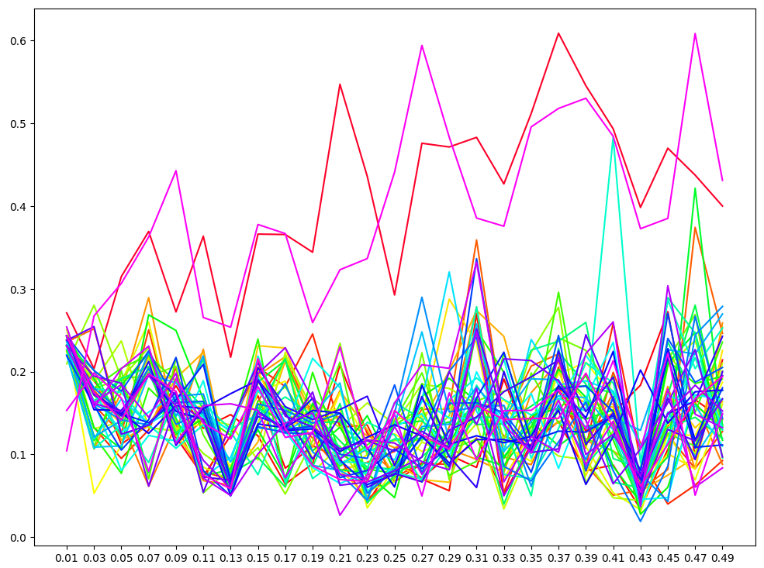
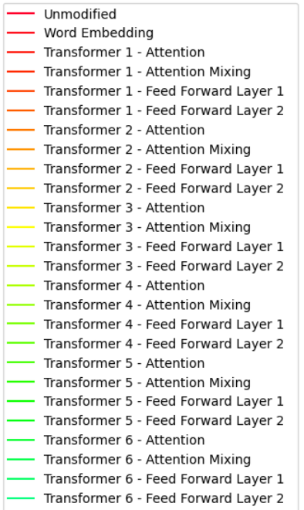
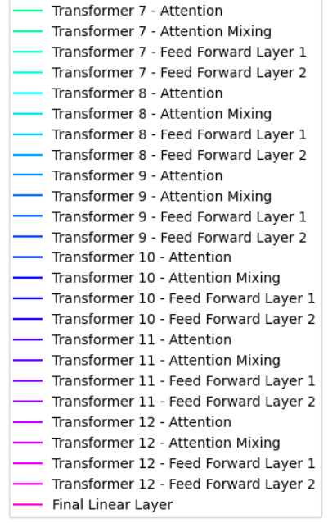
Results
Trustworthy Machine Learning - Project
04/05/2024

Slide 30
Results
With 51 separate plots, there is a lot to keep track of, and it very hard to ascertain any patterns from the data
The two values that maintain the best meaning, by far, are the unmodified model and the one that has the final feed forward layer of the final transformer modified
The unmodified model is the baseline, the modified model may equal its performance because setting the values to 0 only brings the logits closer to 0 in general, so it has the same prediction but with less confidence
Trustworthy Machine Learning - Project
04/05/2024

Slide 31
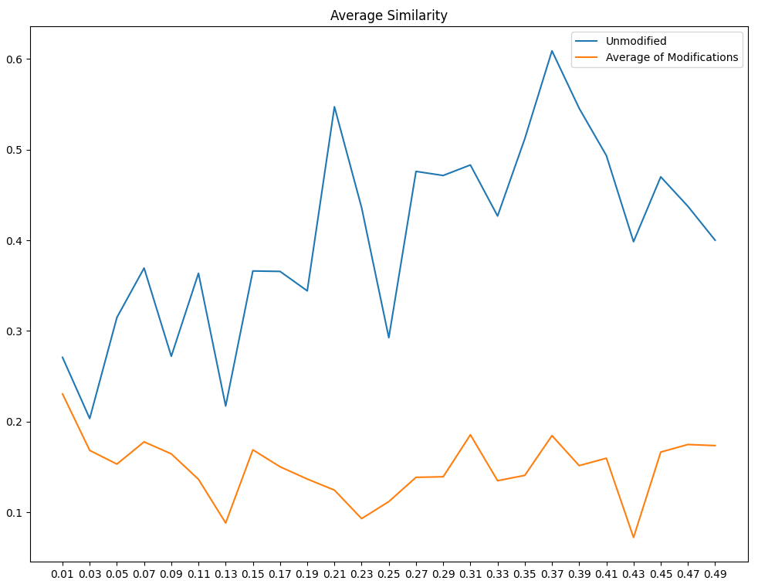
Results
Unmodified model appears to slowly increase similarity, but this is a product of noise, since the model has not changed due to ν
The modifications decrease quickly at very small values of ν then remain roughly constant at approximately 0.15
Trustworthy Machine Learning - Project
04/05/2024

Slide 32
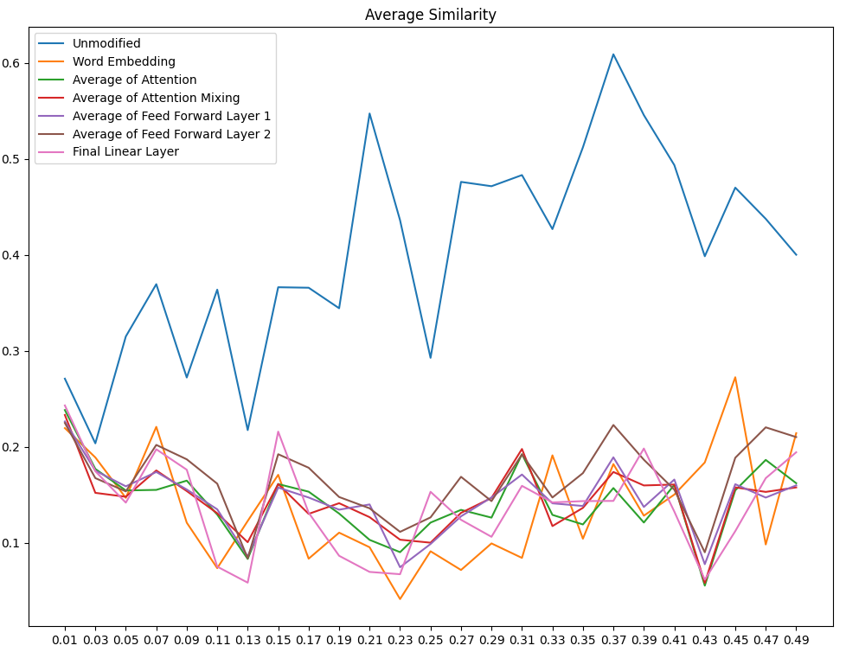
Results
The layers within the transformed do not seem to have any relative importance to each other
The initial word embedding is most likely the most damaging area to make a modification in, followed by the final linear layer
Trustworthy Machine Learning - Project
04/05/2024

Slide 33
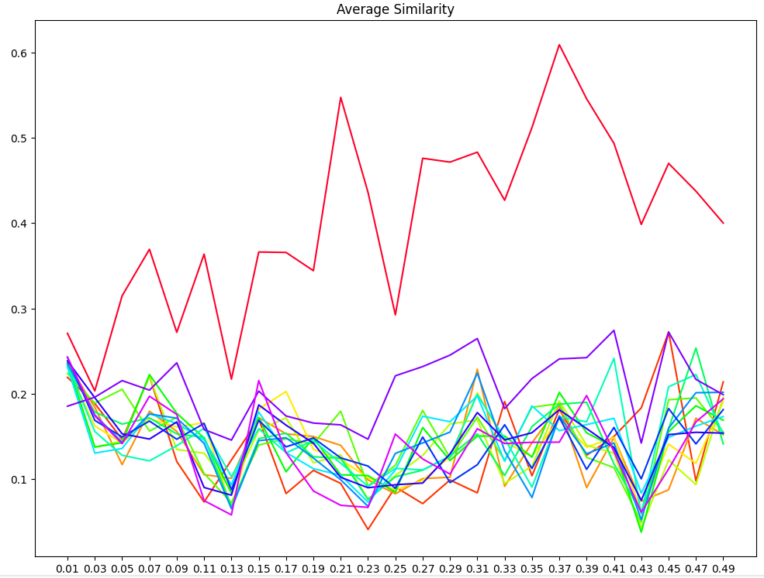
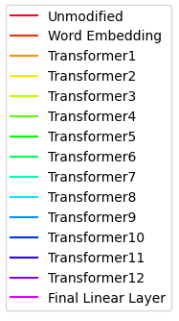
Results
Trustworthy Machine Learning - Project
04/05/2024

Slide 34
Results
Of the transformers, the 12th transformer is the best to modify, followed by the 6th transformer
Result for the 12th transformer might be because of the very high values for the final feed forward layer in that transformer
Worst are again the word embedding and final linear layer values, though by less than when compared to features within a transformer
Trustworthy Machine Learning - Project
04/05/2024

Slide 35
Results
The mean amount of similarity across all trials was 0.154, and the median was 0.145.
The only individual features that were more than 0.02 away from the median were the unmodified model (0.404) and transformer 12, feed forward network layer 2 (0.391).
The 5 features with the most removal of similarity (on average) were transformer 3, feed forward layer 1 (0.132 similarity remaining); transformer 1, attention mixing (0.132); transformer 3, feed forward layer 2 (0.131); transformer 2, attention (0.129), and transformer 1, attention (0.126)
Trustworthy Machine Learning - Project
04/05/2024

Slide 36
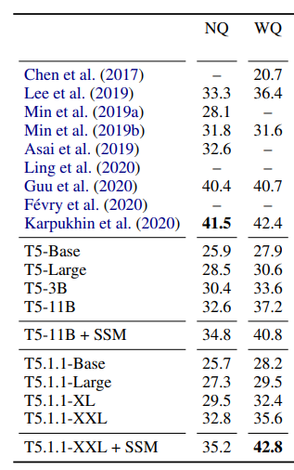
Results
Overall, the unmodified average is 40.9%, which compares favorably to other results
However, results are not comparable, since the table figures are the percentage of exact or near-exact matches, while the results here give 50% credit for sentences that are 50% similar
Modified average is 14.9%, which is worse than every other result even after giving every possible amount of partial credit
Trustworthy Machine Learning - Project
04/05/2024

Slide 37
Results
On the whole, not too much was learned from measuring similarity by layer, but may have been too noisy (too few trials) to learn the actual pattern
Three observations stood out:
The final feed forward layer really does not matter, and removing data from it almost did not change performance
Of the five layers that most changed, all were in the first three transformers, suggesting that the earliest ones may hold the most information
Trustworthy Machine Learning - Project
04/05/2024

Slide 38
Results
The value of ν almost does not matter, at least for ν < 0.5, since there was little movement in the average between 0.05 and 0.49
For the actual dataset creation, I will choose ν = 0.3, since that seems to have one of the largest gaps between the best and worst-performing layers (though it likely is noise), and actual performance does not seem to degrade near that point
Trustworthy Machine Learning - Project
04/05/2024

Slide 39
Results
On training the data, only the questions that originally scored at least 50% on similarity were considered
This screened out any noise caused by changing a random dissimilar answer to another random dissimilar answer
On the test data, the predictor accurately assigns 79.72% of the lost meaning to the correct layer
The predictor correctly identifies the most damaging layer 8% of the time, and the layers guessed within the top 5 were among the 5 most damaging layers 27% of the time
Trustworthy Machine Learning - Project
04/05/2024

Slide 40
Results
The most damaging layer, according to the predictor (2nd most damaging by ground truth) is in the 7th transformer, and accounts for 2.72% of the overall change
The least damaging layer, according to the predictor (3rd least by ground truth) is in the 9th transformer, and accounts for 1.06% of the overall change
Ran out of time to break down predictions by category of change, but would be interesting to see if the predictions change at a more specific type of input, or comparing across different but similar inputs
Trustworthy Machine Learning - Project
04/05/2024

Slide 41
Conclusion
Discussion, Drawbacks of the Model, and Conclusions
Even with a smaller model like GPT-2, was not able to offer more specific predictions than at the layer level
There may be specific information coded in weights coming to or from a specific node, which this method would miss
Even separating out key, query, and value would be helpful, because there are presumably different things going on between them (would increase the number of layers analyzed by 48%, and is already fairly unwieldy)
Trustworthy Machine Learning - Project
04/05/2024

Slide 42
Conclusion
Similarity value predicted by evaluator might not capture the full extent to whether the two answers are similar or correct
If expected a numerical answer and was given the wrong numerical answer, it would be marked as very similar even though it was incorrect
Not able to distinguish between multiple types of dissimilarity - a completely nongrammatical answer would be marked the same as a thoroughly irrelevant answer, even though they display very different behavior
Trustworthy Machine Learning - Project
04/05/2024

Slide 43
Conclusion
Generator might also be too small to have consistently useful information about redundant parameters; language is complex, and the 124 million parameters simply may not be enough to encode all the information, so they are all working for all the inputs
In that case, the results derived from this experiment would be somewhat arbitrary, and not scale well to other and larger models
Regardless, it is an interesting first look into the effects and relative impacts of the various features of a large language model
Trustworthy Machine Learning - Project
04/05/2024

Slide 45
Appendix - Code
Code is at https://github.com/ACE3R2/TML-Project/blob/main/experiment.py
The code was run on Google Colab, so the breaks are the spaces between jupyter cells
A condensed version (removes unnecessary cells, comments, cell breaks) that might be runnable on normal python (disclaimer: haven’t tested it) can be found at experiment_condensed.py
Old trial versions are found in old/ in that repository
Trustworthy Machine Learning - Project
04/05/2024

